Slide 1

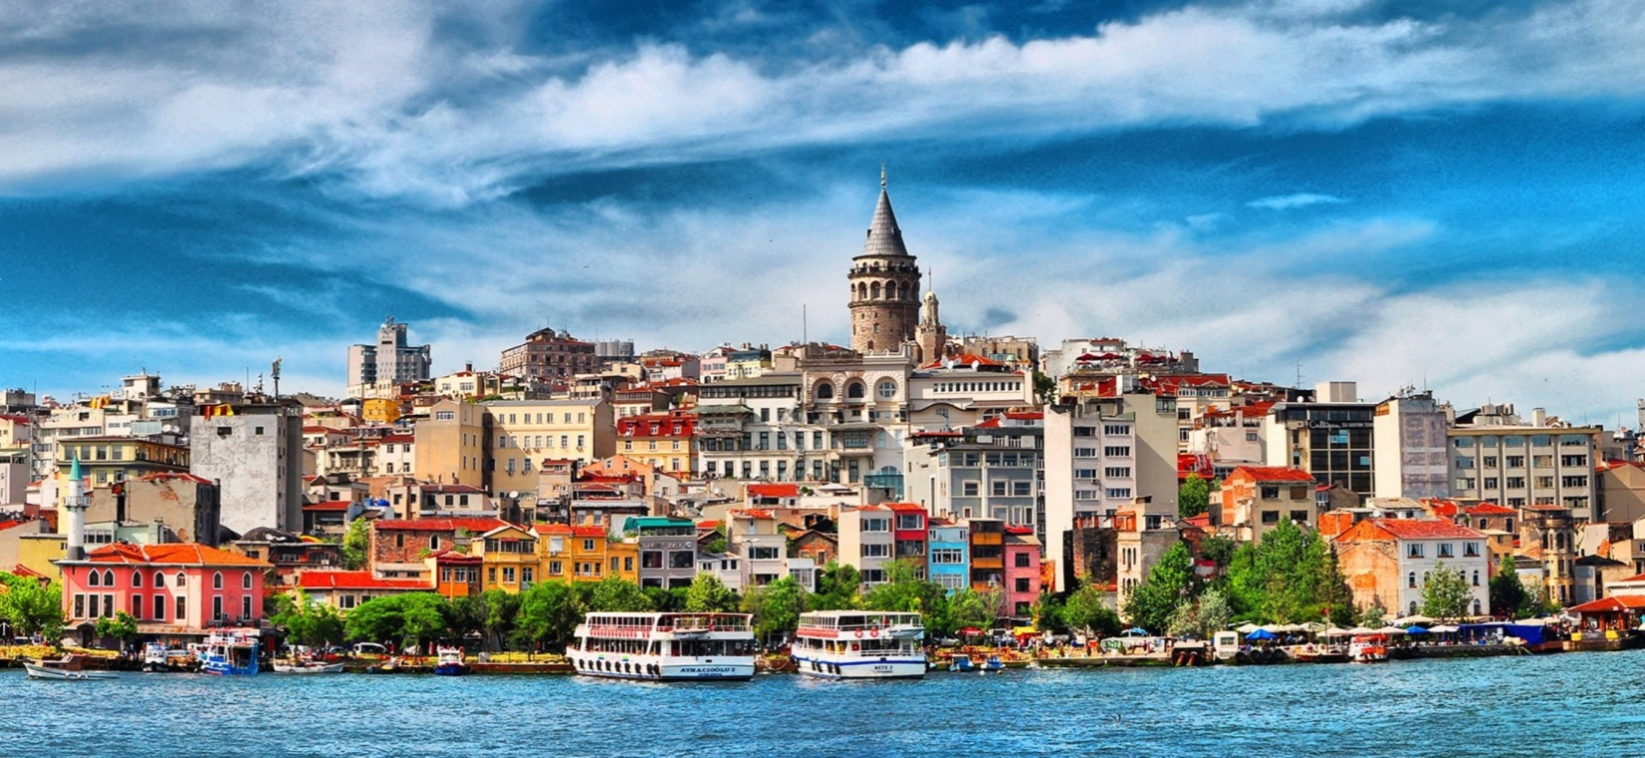
ISTANBUL,
17 – 19 November 2015

Slide 2

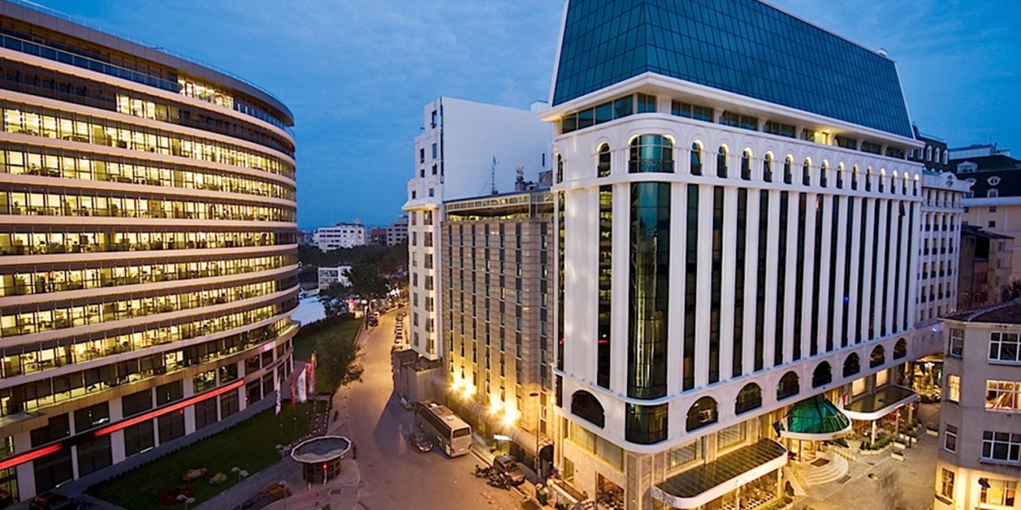
Elite World İstanbul 5*
Accommodation
http://www.eliteworldistanbul.com.tr/default-en.html
Single room : 100 € including buffet breakfast
Portarage : 5 € per person (in & out)
Half day meeting package : 30 € per person including
*Meeting room rental between 09:00 – 13:00
*1 coffee break with cookies
*Lunch with 1 soft drink
*Screen & wireless internet
Full day meeting package : 35 € per person including
*Meeting room rental between 09:00 – 18:00
*2 coffee break with cookies
*Lunch with 1 soft drink
*Screen & wireless internet
Dinner in hotel: starting from 30 € per person
Unlimited local drinks: 22 € per person (max 2,5 hours)

Slide 3
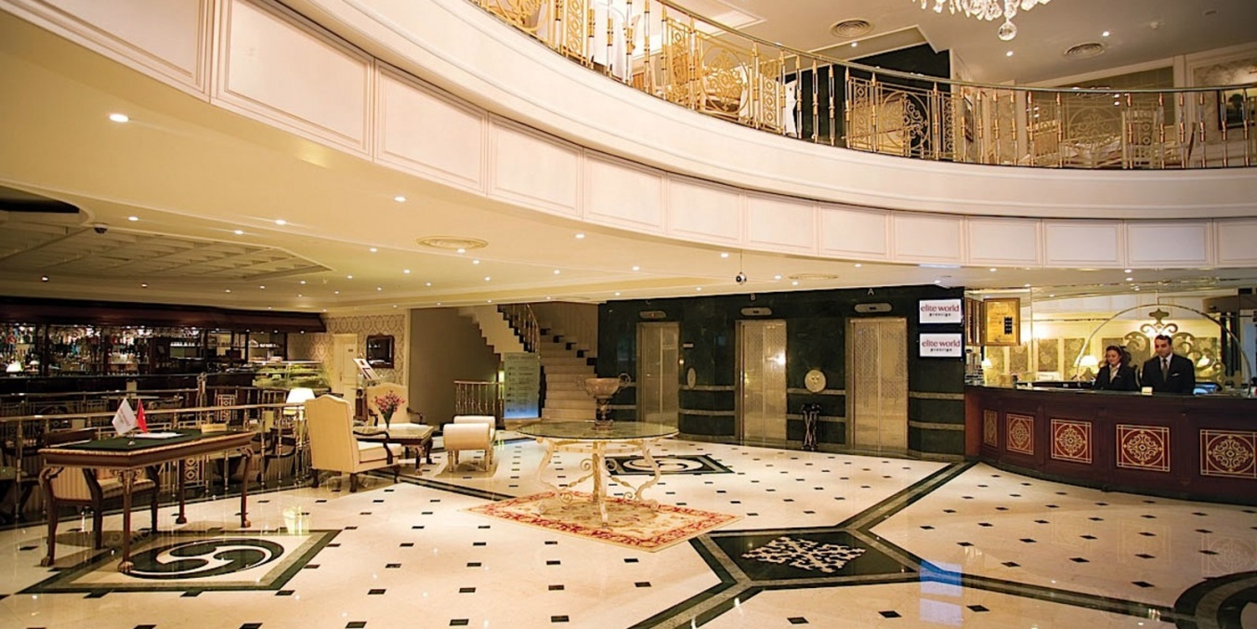
Elite World Prestige 4*
Accommodation
http://www.eliteworldprestige.com.tr/default-en.html
Single room : 85 € including buffet breakfast
Portarage : 5 € per person (in & out)
Half day meeting package : 30 € per person including
*Meeting room rental between 09:00 – 13:00
*1 coffee break with cookies
*Lunch with 1 soft drink
*Screen & wireless internet
Full day meeting package : 35 € per person including
*Meeting room rental between 09:00 – 18:00
*2 coffee break with cookies
*Lunch with 1 soft drink
*Screen & wireless internet
Dinner in hotel: starting from 25 € per person
Unlimited local drinks: 18 € per person

Slide 4
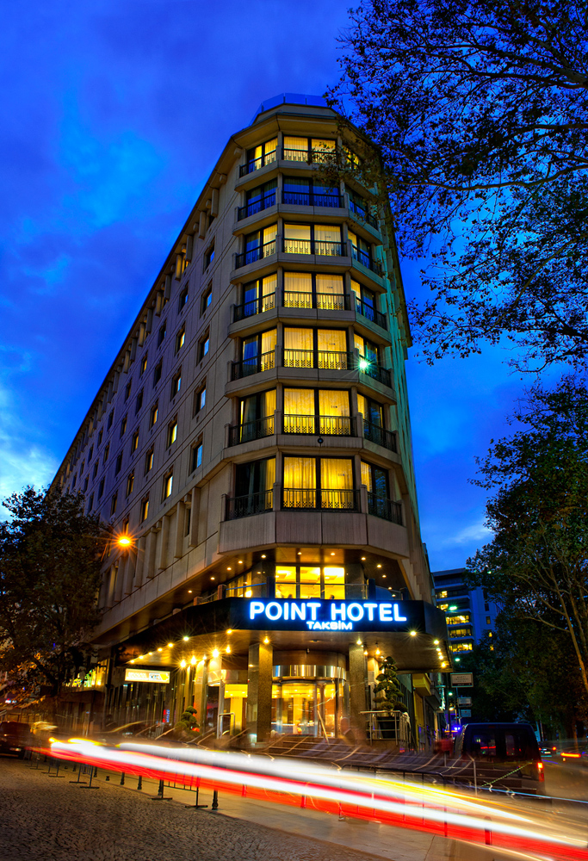
Point Hotel Taksim 5*
Accommodation
http://www.pointhotel.com/point-hotel-taksim-home-page.aspx
Single standart room : 85 € including buffet breakfast
Portarage : 5 € per person (in & out)
Half day meeting package : 40 € per person including
*Meeting room rental between 09:00 – 13:00
*1 coffee break with cookies
*Lunch with 1 soft drink
*Screen & wireless internet
Full day meeting package : 48 € per person including
*Meeting room rental between 09:00 – 18:00
*2 coffee break with cookies
*Lunch with 1 soft drink
*Screen & wireless internet
Dinner in hotel: 40 € per person
Unlimited local drinks: 28 € per person

Slide 5
Lares Park Hotel Taksim 4* sup
Accommodation
http://www.laresparkhotel.com/default-en.html
Single standart room : 90 € including buffet breakfast
Portarage : 5 € per person (in & out)
Half day meeting package : 27 € per person including
*Meeting room rental between 09:00 – 13:00
*1 coffee break with cookies
*Lunch with 1 soft drink
*Screen & wireless internet
Full day meeting package : 30 € per person including
*Meeting room rental between 09:00 – 18:00
*2 coffee break with cookies
*Lunch with 1 soft drink
*Screen & wireless internet
Dinner in hotel: 28 € per person (including 1 soft drink)
Unlimited local drinks: 28 € per person

Slide 6
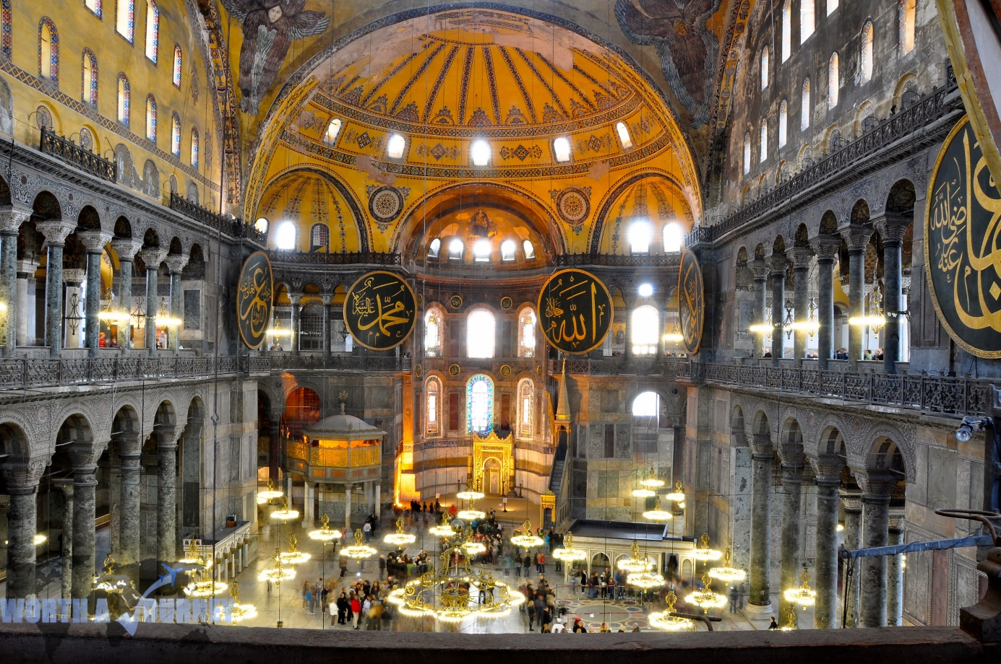
City sightseeing
ISTANBUL
1. ISTANBUL CLASSIC (Half day tour)
BLUE MOSQUE, facing Hagia Sophia, famous with its blue İznik tiles and unique with 6 minarets, built in the name of Sultan Ahmet.
HIPPODROME, center of sportive events (chariot races, athletics) and political activities of the old city. Serpentine Column, Obelisk of Theodosius, German Fountain of Wilhelm II are the monuments decorating the Hippodrome
HAGIA SOPHIA, one of the greatest marvels of architecture, constructed as a basilica in the 6th century by Emperor Justinian.
GRAND COVERED BAZAAR, most attractive shopping center and biggest "souk" in the world with nearly 4000 shops selling antiques, jewellery, gold, carpets, leatherware and souvenirs.
Cost pp : 35.- € including bus, English speaking guide

Slide 7
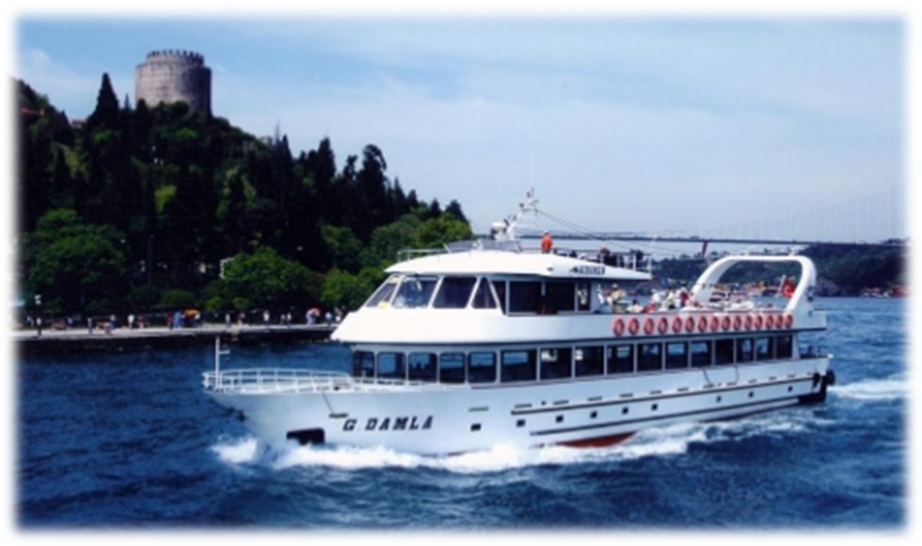
City sightseeing
ISTANBUL
2. BOSPHORUS CRUISE (Half day tour)
SPICE BAZAAR (Egyptian Bazaar), mystical smells of different aromas of various spices. Shops selling fruits, vegetables, fish, flowers etc.
BOSPHORUS CRUISE, through the waterway separating the two continents, Europe and Asia, with a possibility to take photographs of marble palaces, ancient wooden villas of Ottoman architecture besides modern residentials and luxurious apartments.
Cost pp : 40.- € including bus, English speaking guide & private boat 1,5 hrs.

Slide 8
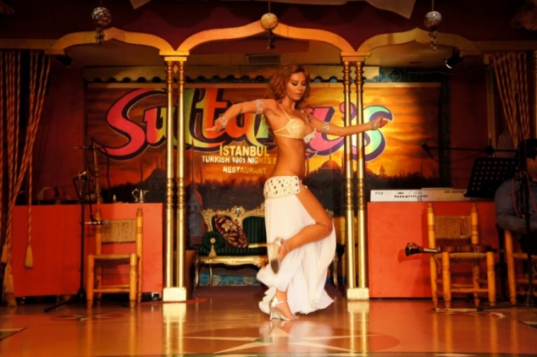
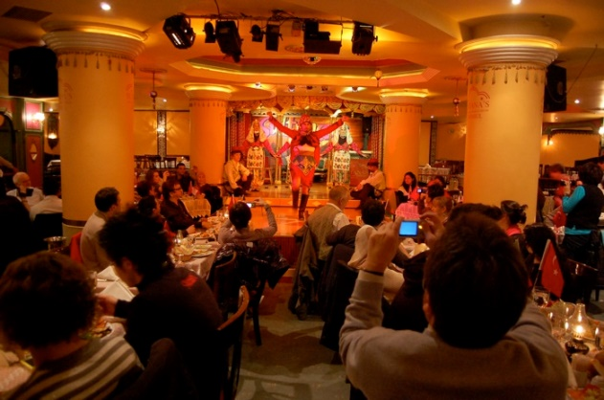
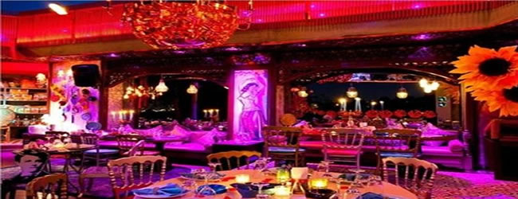
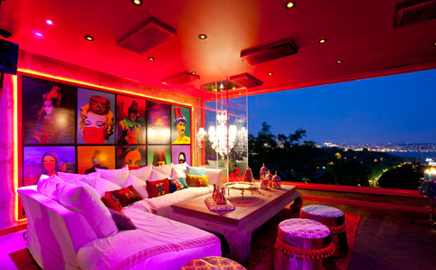
Sultana’s Night Club http://www.sultanas-nights.com/
Dinner alternatives
Cost per person: 60 €
Including; dinner, limited drink (2 glasses), Turkish Belly Dancer
Arabesque Restaurant
Cost per person: 100 €
Arabesque successfully combines the oriental spirit with with its delicious food, incredible interior design, colorful shows and fabulous belly dancing performance.
including night show, unlimited local alcoholic or soft drinks (until midnight), transfer in & out with luxury coach and English speaking guide

Slide 9
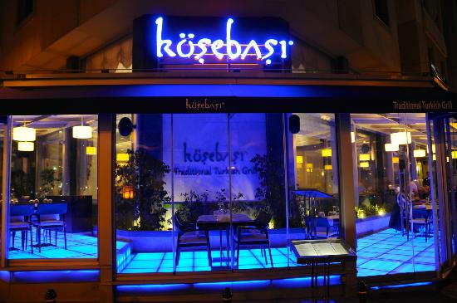
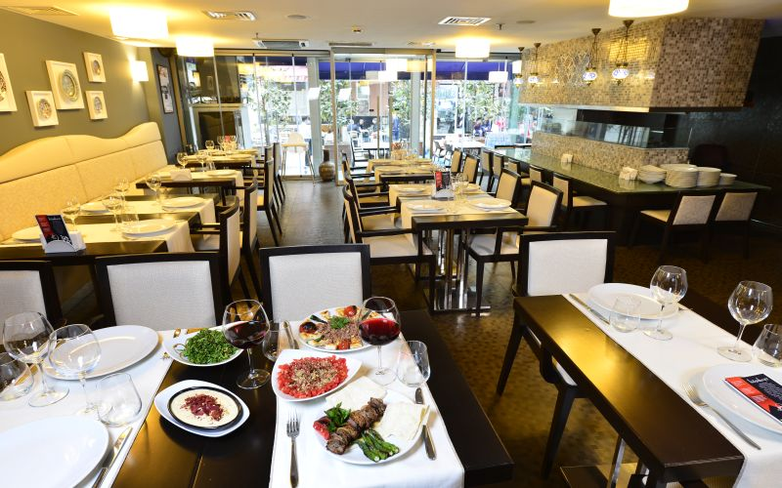
Köşebaşı Restaurant (Taksim) www.kosebasi.com.tr
Dinner alternatives
Cost per person: 40 €
Including; dinner (special kebap menu), soft drink (1 glass)

Slide 10
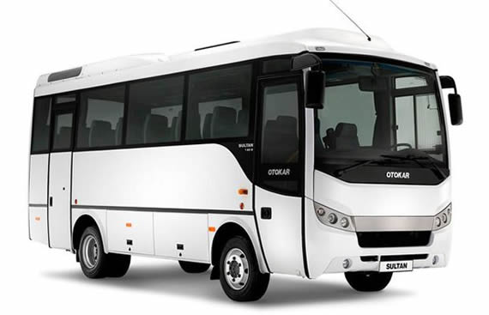
ISTANBUL
Airport Transfer
Airport transfer to / from hotel (one way) : 18€ pp
based for min. 15 pax
including luxury coach (27 seater) & English speaking guide
Asistance
- All mentioned costs are net and inclusive of taxes.
- Technical equipment costs will be given on request. (video projector : 80 € daily)
- Any increase on taxes declared by the Turkish government will be applied on the costs given.

